Slide 1

Welcome to your local CanJS Meetup!
Goals
Future Meetups
Bithub
CanJS 2.0 Overview
TodoMVC
QA / Open Forum
@justinbmeyer
Notes:
I am Justin Meyer
Welcome to the first CanJS meetup!
Today we are going to talk:
a bit about the goals for these meetups.
Give an introduction to CanJS 2.0 while we build TodoMVC with CanJS.
Finally, we’ll end with QA and an open forum for questions.

Slide 2
Meetup Checklist
Big thanks to Mindjet!
Make sure audience asks questions.
Gauge audience’s experience.
What does the audience want?
Notes:
Now to scratch off a checkboxes on my meetup checklist:
Thank Cars.com hosting us.
1. I like an interactive meetup. If you have a question / thought, raise your hand immediately.
2. How many people:
Are using CanJS daily?
Have experimented with CanJS?
Know almost nothing about canjs?
What would you like from this meetup? What do you want to get out of it?

Slide 3


Slide 4
Community Goals
Learn > Love > Evangelize > Contribute

Slide 5
Meetup Locations
Chicago
Los Angeles
San Francisco
Raleigh
Dallas
Fort Lauderdale
Seattle
Phoenix
New York
Boston

Slide 6
Future meetup material
can.Map and can.List
can.compute
can.Mustache
can.Component
can.Control
can.Model and can.fixture
can.route
can.control
can.EJS
Architecture
Testing
Contributing
Notes:
Be an expert at CanJS in 12 months.

Slide 7
Meetup Goals
Become an expert
Get help
Make friends
Notes:
Be an expert at CanJS in 12 months.

Slide 8
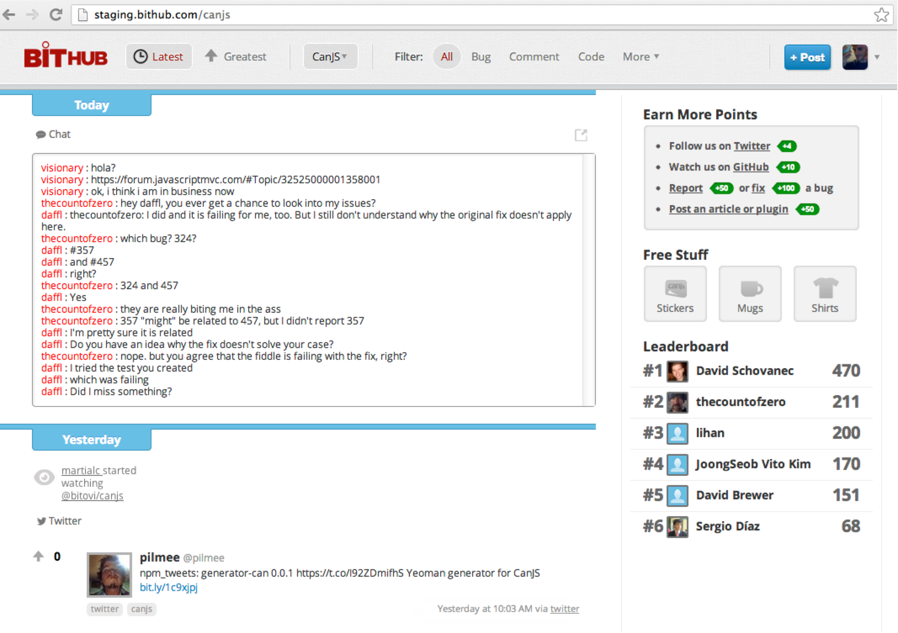
Easy to Learn - Community

Slide 9
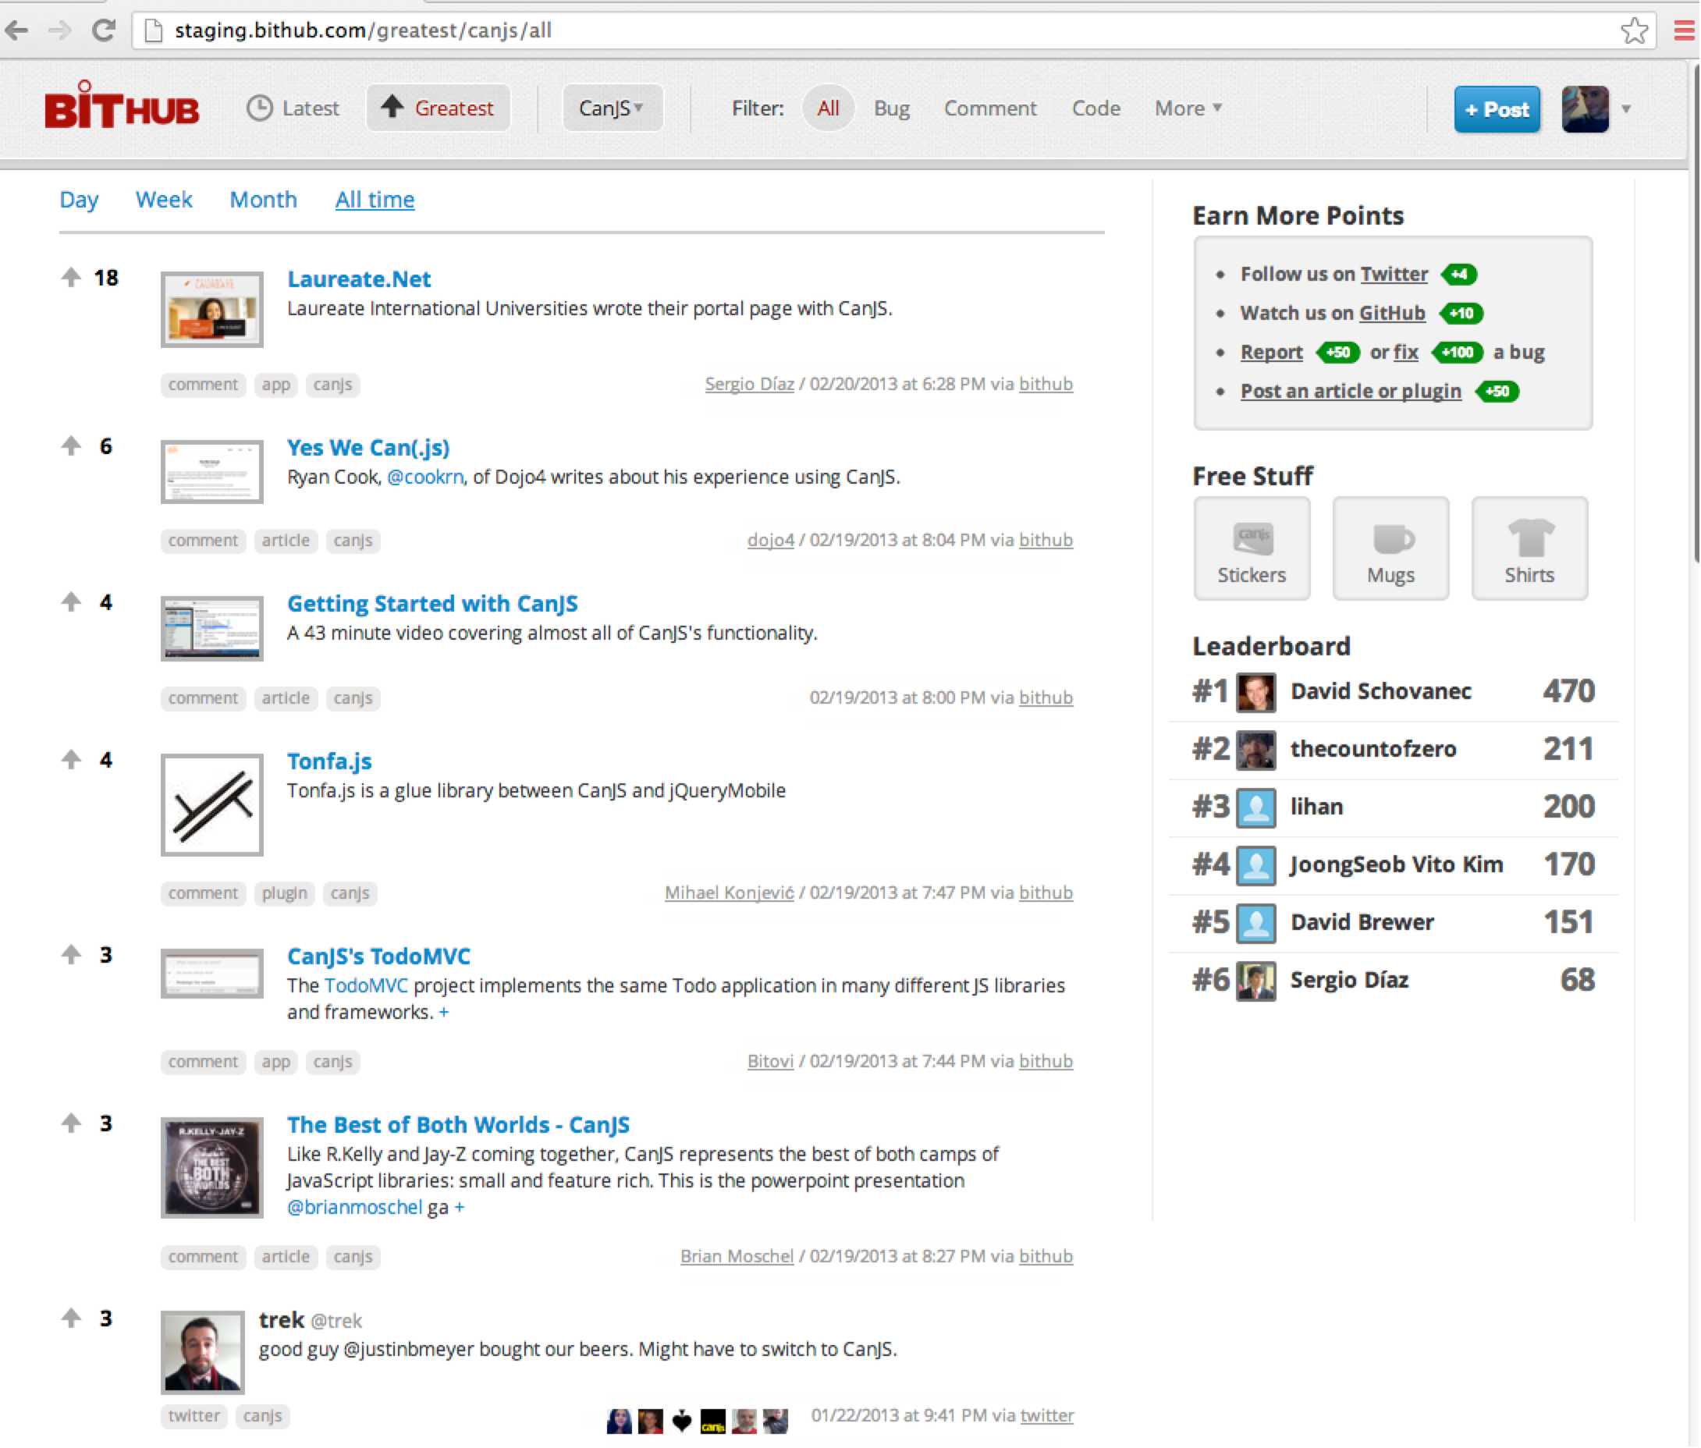

Slide 10
1.1 Features
Constructors can.Construct
Observables can.Map, can.List, can.compute
Models can.Model
Routing can.route
Templates can.view.ejs, can.view.mustache
Controls can.Control
Notes:
JavaScript has 10 basic data types.
mutable

Slide 11
can.Construct.extend(s,p)
var Person = can.Construct.extend({
init: function (name) {
this.name = name;
}
});
var curtis = new Person("Curtis");
curtis.name
Notes:
JavaScript has 10 basic data types.
mutable

Slide 12
new can.Map(data)
var person = new can.Map({name:'josh'});
person.attr('name') //-> 'josh'
person.bind('name',function(ev,newVal,oldVal){
newVal //-> 'Justin'
oldVal //-> 'josh'
});
person.attr('name','Justin');
Notes:
JavaScript has 10 basic data types.
mutable

Slide 13
new can.List(data)
var hobbies = new can.List(['JS']);
hobbies.attr('0') //-> 'JS'
hobbies.bind('add',function(ev,items,index){
items //-> ['bball','hip hop']
index //-> 1
});
hobbies.push(['bball','hip hop']);
Notes:
JavaScript has 10 basic data types.
mutable

Slide 14
can.compute(data)
var age = can.compute(30);
age(); //-> 30
age.bind('change',function(ev,newVal,oldVal){
newVal //-> 31
oldVal //-> 30
});
age(31);
Notes:
JavaScript has 10 basic data types.
mutable

Slide 15
can.compute(getter)
var info = can.compute(function(){
return person.attr("name")+" is "+age()+
" and likes: "+hobbies.join(', ')
});
info() //-> "Justin is 31 and likes
// JS, bball, hip hop"
info.bind('change',function(ev,newVal,oldVal){
newVal //-> "Justin is 31 and likes
// JS, bball"
});
hobbies.pop();
Notes:
JavaScript has 10 basic data types.
mutable

Slide 16
can.Model.extend(s,p)
var Task = can.Model.extend({
findAll: "GET /tasks",
findOne: "GET /tasks/{id}",
create: "POST /tasks",
update: "PUT /tasks/{id}",
destroy: "DELETE /tasks/{id}"
},{})
Task.findAll({due:"today"},function(tasks){})
Task.findOne({id: 51},function(task){});
Notes:
JavaScript has 10 basic data types.
mutable

Slide 17
can.Model.extend(s,p)
var task = new Task({name:"Mow lawn."});
task.save(function(){
task.attr("name","Mow and trim lawn.")
.save(function(){
task.destroy()
})
})
Notes:
JavaScript has 10 basic data types.
mutable

Slide 18
can.route(route,defaults)
can.route("tasks/:id",{
type: "tasks"
});
can.route.bind("change", function(){
if(can.route.attr('type') == "tasks"){
var id = can.route.attr('id’);
if( id ){
Task.findOne({id: id});
}e
}
});
Notes:
JavaScript has 10 basic data types.
mutable

Slide 19
Mustache / Handlebars
{{#if devs.length}}
{{#each devs}}
<li>{{name}}</li>
{{/each}}
{{else}}
<li>No Developers</li>
{{/if}}
can.view('devs.mustache',{
devs: new can.List([{name:'Andy'}])
})
Notes:
JavaScript has 10 basic data types.
mutable

Slide 20
EJS
<% if( devs.attr('length') ) { %>
<% devs.each(function(dev){ %>
<li><%= dev.attr('name') %></li>
<% }) %>
<% } else { %>
<li>No Developers</li>
<% } %>
can.view('devs.ejs',{
devs: new can.List([{name:'Andy'}])
})
Notes:
JavaScript has 10 basic data types.
mutable

Slide 21
can.Control.extend( p )
var Tabs = can.Control.extend({
init: function( el ) {
// show first tab
},
'li click': function( el, ev ) {
// hide other tabs
// show selected tab
}
});
new Tabs('#tabs');
Notes:
JavaScript has 10 basic data types.
mutable

Slide 22

2.0 Features!
2-way binding can-value="value"
View binding can-click="method"
Custom tags <tabs>
Components can.Component
Notes:
JavaScript has 10 basic data types.
mutable

Slide 23

var HyperLoop = can.Map.extend({
travelTime: function(){
return this.attr('dist')
/
962 /* km/h */
}
})
var loop = new HyperLoop({
dist: 3429.19 /* Chi <-> SF */
})
var tmp = can.view.mustache(
"<p>Distance: \
<input can-value=’dist'/>\
</p> \
<p>Time: \
{{travelTime}} hrs \
</p>")
$("#out").html( tmp(loop) )

Slide 24
can.Component.extend(p)
can.Component.extend({
tag:"panel",
template: "{{#if active}}<content>…",
scope: {
active: false
},
helpers: {}
events: {
inserted: function(){...}
}
})
Notes:
Create a control
Has a view model that you make changes to
Those changes are reflected in some template
You still need to listen to events, especially DOM mutation events

Slide 25
can.Component.extend(p)
<tabs>
{{#each foodTypes}}
<panel title='title'>
{{content}}
</panel>
{{/each}}
</tabs>
var foodTypes= new can.List([
{title:"Fruits",content:"oranges"}, …
])
Notes:
DEMO

Slide 26
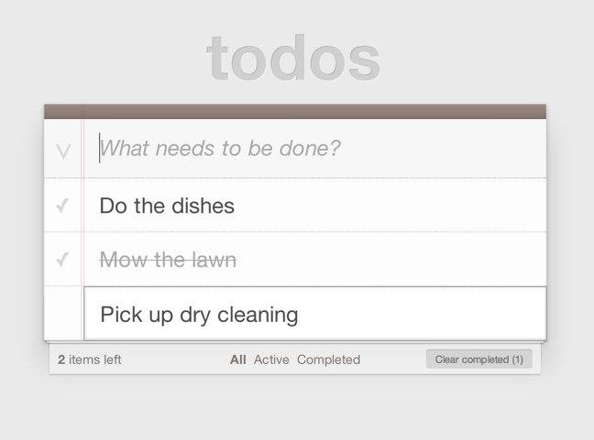
TodoMVC

Slide 27
Forever Features!
Hash Pattern Matching
EJS
Event Delegation
Instance Controllers
Templated events
Class
Model
Observables
Live binding
State routing
Mustache
CanJS 1.0
CanJS 1.1
can.compute
2007 | 2008 | 2009 | 2010 | 2011 | 2012 | 2013
Notes:
JavaScript has 10 basic data types.
mutable

Slide 28
Depth!
Nested objects
Deferreds
Model store
Plugins
computes from anything
Notes:
JavaScript has 10 basic data types.
mutable

Slide 29
Nested Objects
var me = new can.Map({
name: {first: "Justin", last: "Meyer"},
age: 30
})
me.attr("name.first") //-> "Justin"
me.bind("name.first", function(ev, newVal){
newVal //-> "Justin"
});
me.attr("name.first","Lincoln")
Notes:
JavaScript has 10 basic data types.
mutable

Slide 30
Deferreds
var tasksDeferred = Task.findAll({})
tasksDeferred.then(
function(tasks){
},
function(jQXhr, textStatus, errorThrown){
})
Notes:
JavaScript has 10 basic data types.
mutable

Slide 31
Model Store
Critical
Due Today
File Taxes
Write talk on CanJS
Emissions Test
Brush Teeth
Write talk on CanJS
Check into flight
Notes:
The next way CanJS helps with memory is through it’s non-leaking global store.
Say we have 2 Todo lists, Critical Todos and today’s todos. These lists might get back data for the same instance of a todo. The problem happens when a user changes properties on a todo that exists in both lists. Both lists need to be listening to property changes on the same todo instance.
Model needs to see that the data it retrieves belongs to the same instance and return the previously created instance instead of creating a new one.
Most MVC libraries either ignore it or solve it with a model store that has all instances, when data is retrieved for an instance, it checks if the instance is already created and uses that instance instead of creating a new one.
The problem with this is for long-lived applications, you are constantly collecting unused instances, which fills memory. The developer has to tell the store when to flush instances.
CanJS solves this by keeping things in the store only when it knows you are interested in them. How do you express interest? Well by binding to the instance. So, Model keeps instances in the store only while they have event handlers.
This, combined with templated event handling, means that simply by replacing the todo list ELEMENTs with a list of “Awesome Developers”
<li class=“<%= todo.attr(‘complete’) ? “done” :”” %>” >
Very common, but tricky and critical problem for MVC.
CanJS has a non-leaking global store, that allows it to solve the 2 ‘instance’ problem without permanently storing all model instances.

Slide 32












Model Store
Awesome Developers

Slide 33
Plugins
Validations
Getter / Setter
Backup / Restore
Super
Queue
Delegate
PushState
Fixtures
LazyMap
Notes:
JavaScript has 10 basic data types.
mutable

Slide 34
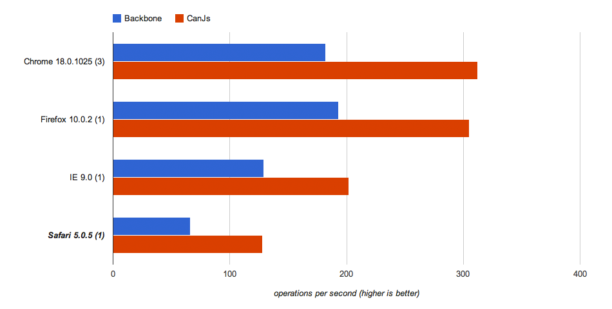
Speed – Tabs Control

Slide 35
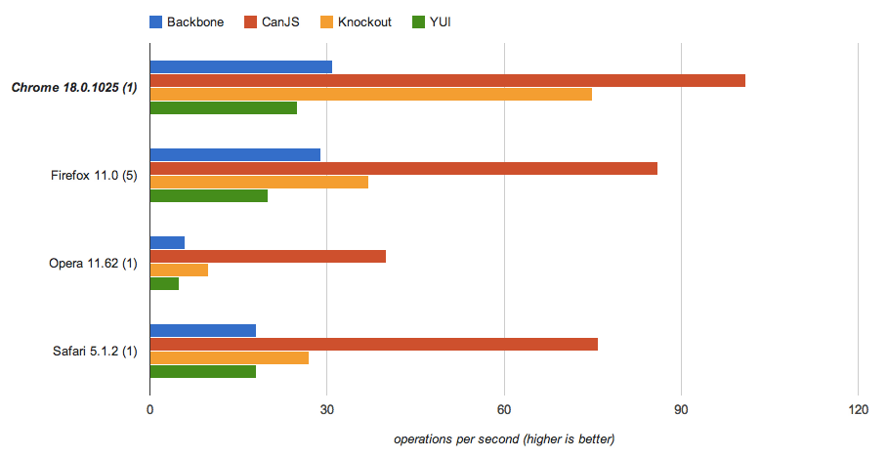
Speed – Live Binding

Slide 36
Speed - Size
 | - jQuery
 | -jQuery +Underscore
 | none
 | none
 | -jQuery -handlebars
CanJS 14.4kb
Backbone 11.4kb
Knockout 15.5kb
Angular 30.2kb
Ember 60.6kb

Slide 37





Flexibility - Library Support
Notes:
Want to appeal

Slide 38
Flexibility – Do it your way
Task = can.Model.extend({
findAll: "/GET /tasks"
},{})
Task = can.Model.extend({
findAll: {
crossDomain: true,
dataType: "jsonp",
jsonpCallback: "callback"
}
},{})

Slide 39
Flexibility – Do it your way
Task = can.Model.extend({
findAll: "/GET /tasks"
},{})
Task = can.Model.extend({
findAll: function(params){
var deferred = $.Deferred();
connect(function(data){
deferred.resolve(Task.models(data))
});
return deferred;
}
},{})
Notes:
views - ejs

Slide 40
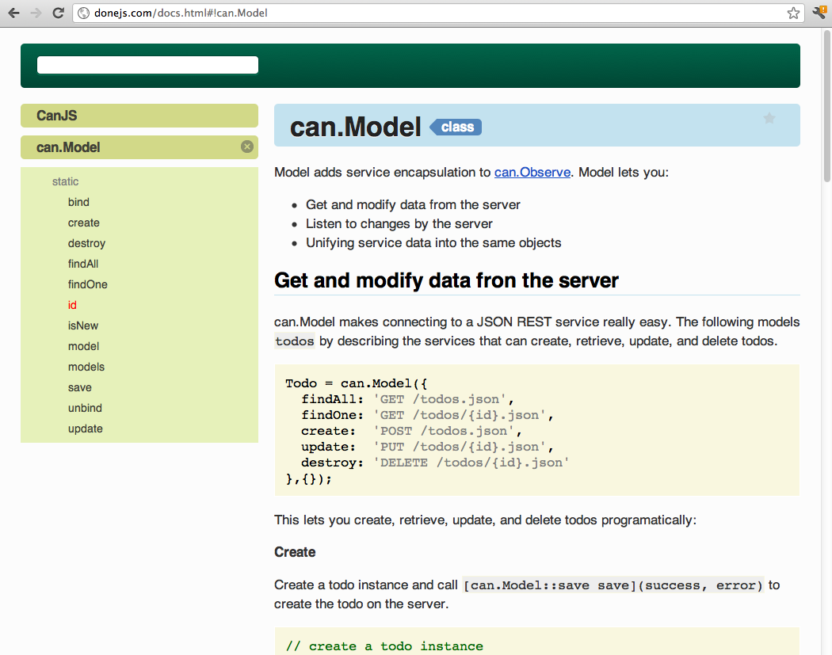
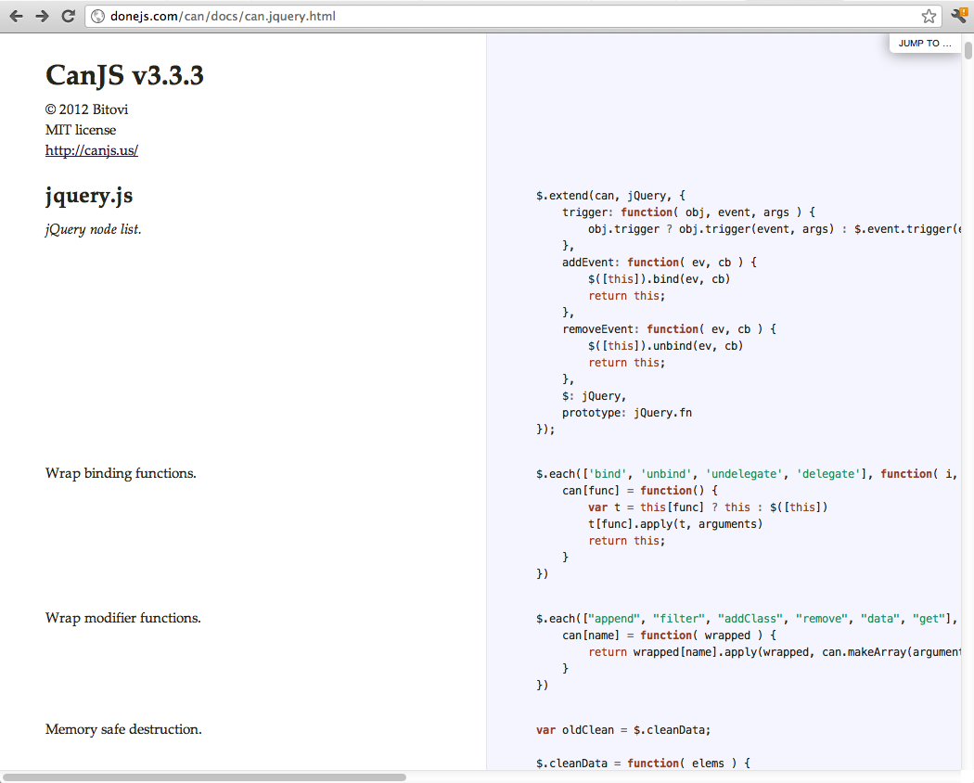
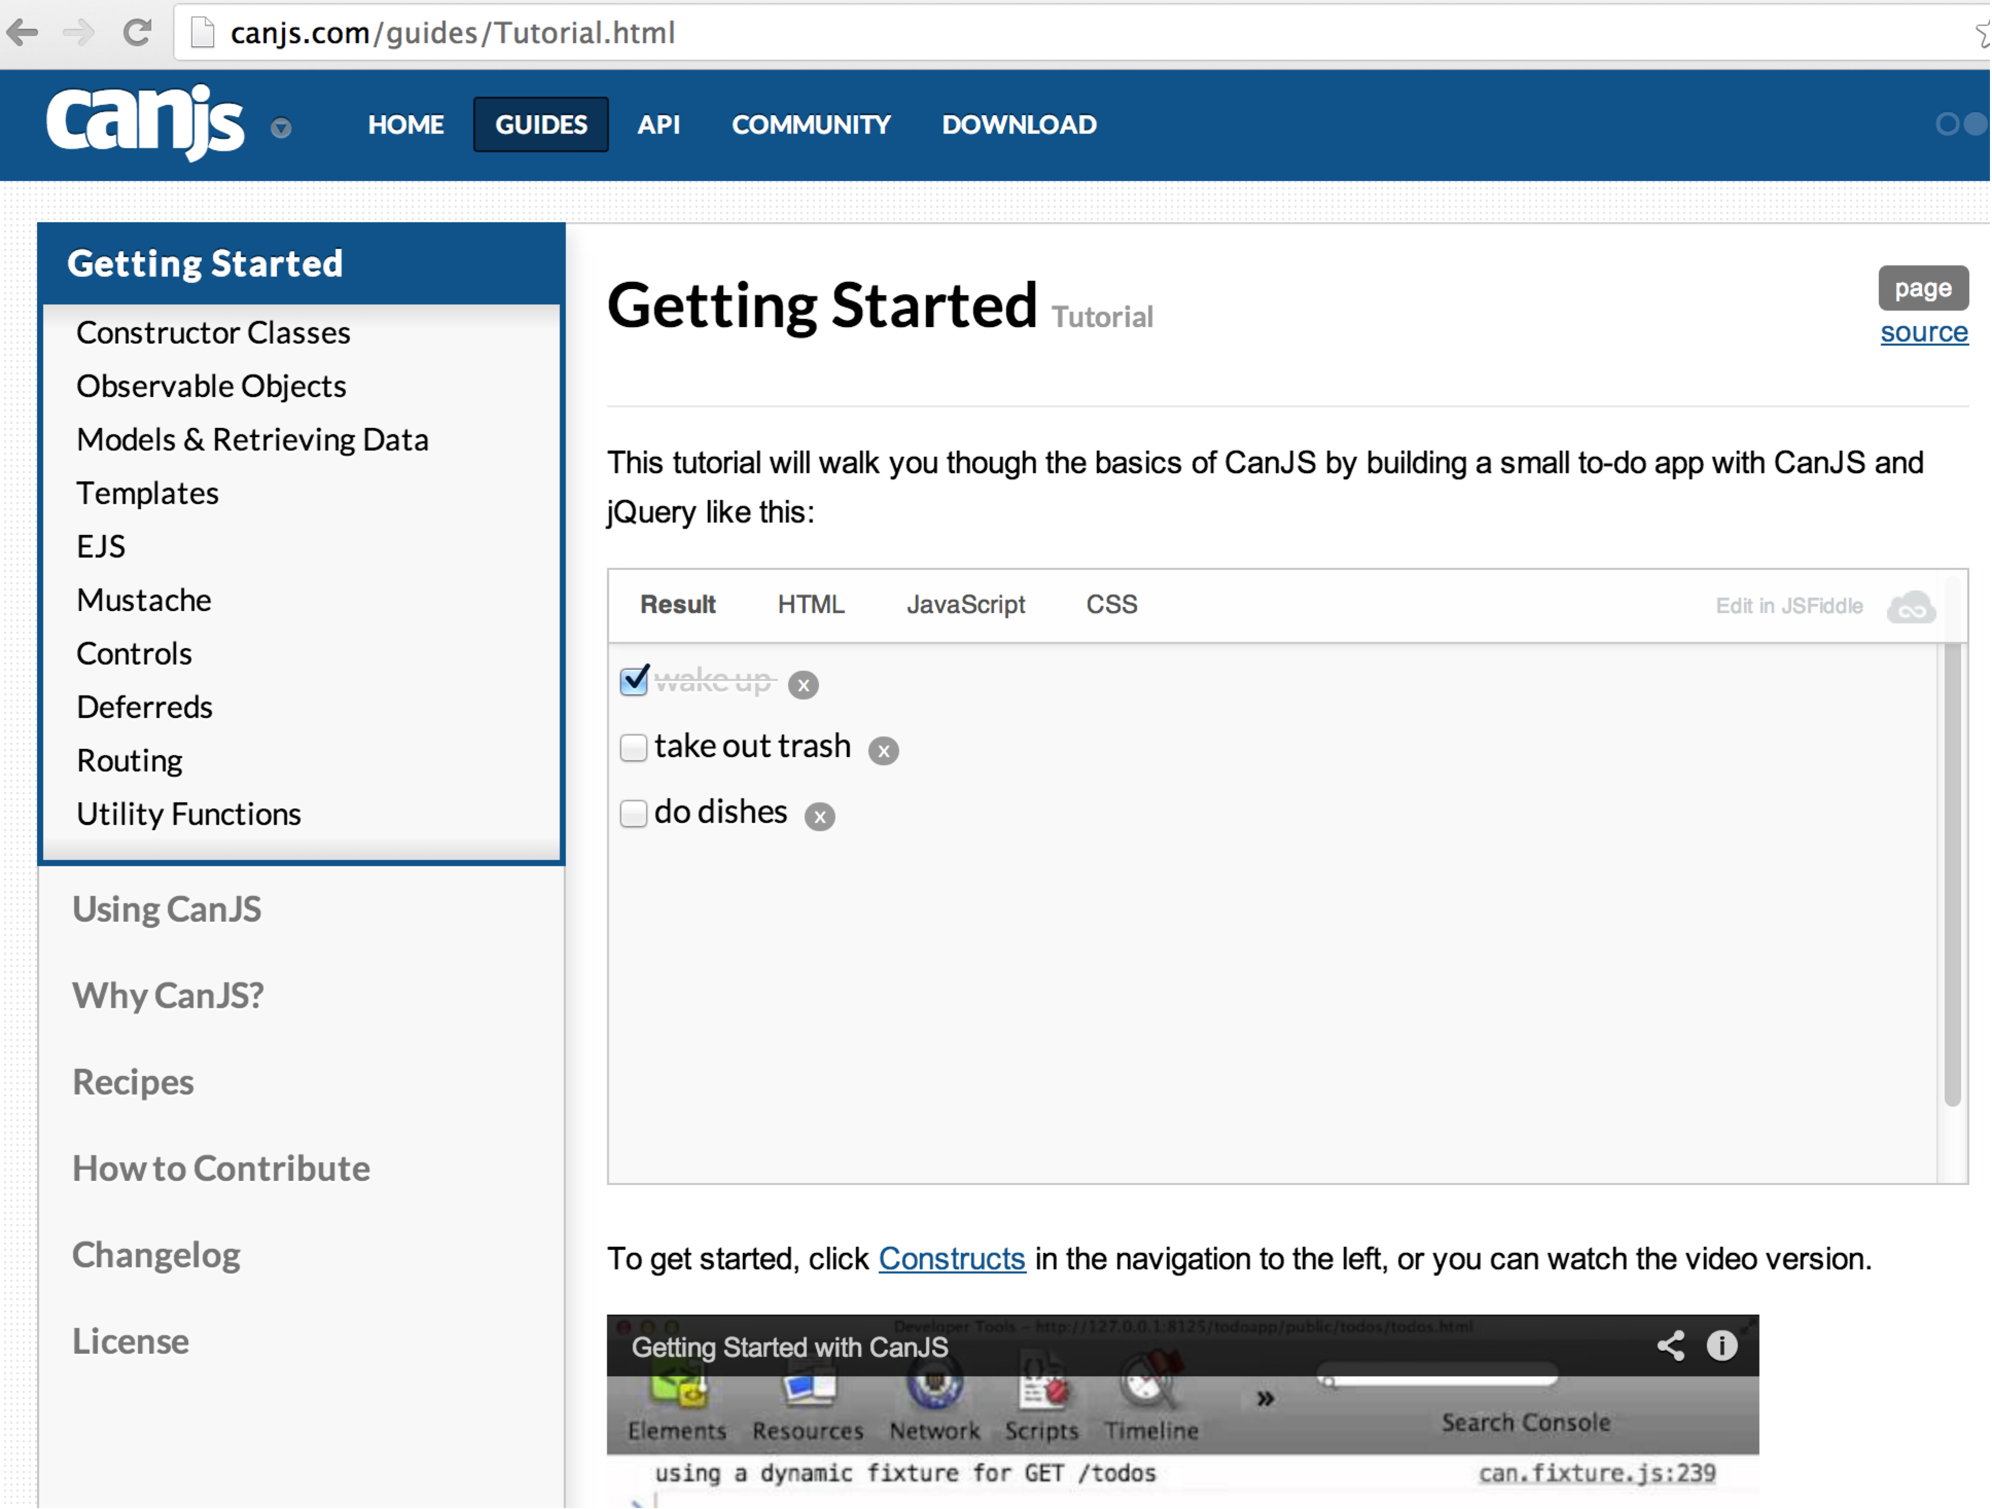
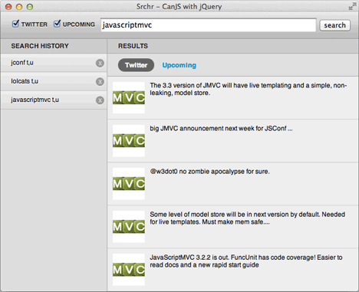
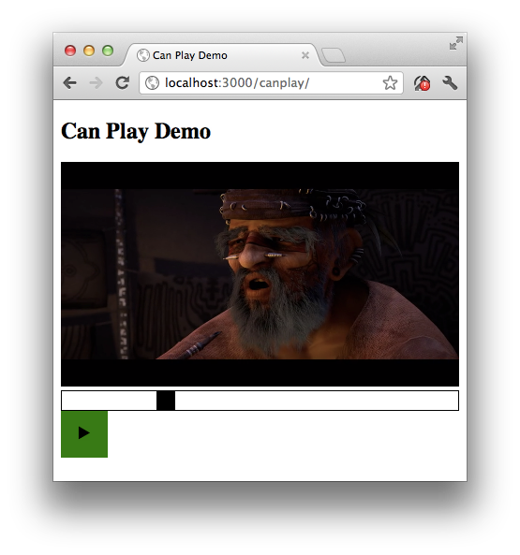
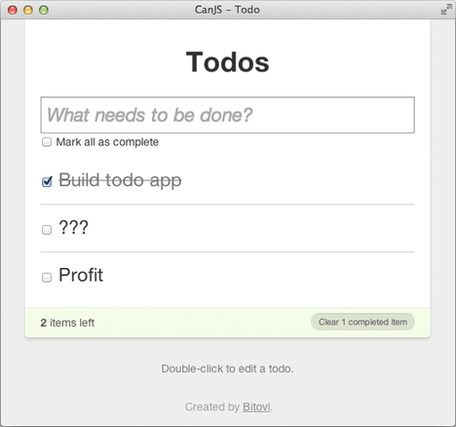
Documentation + Examples

Slide 41
Easy to Learn - Community

Slide 43
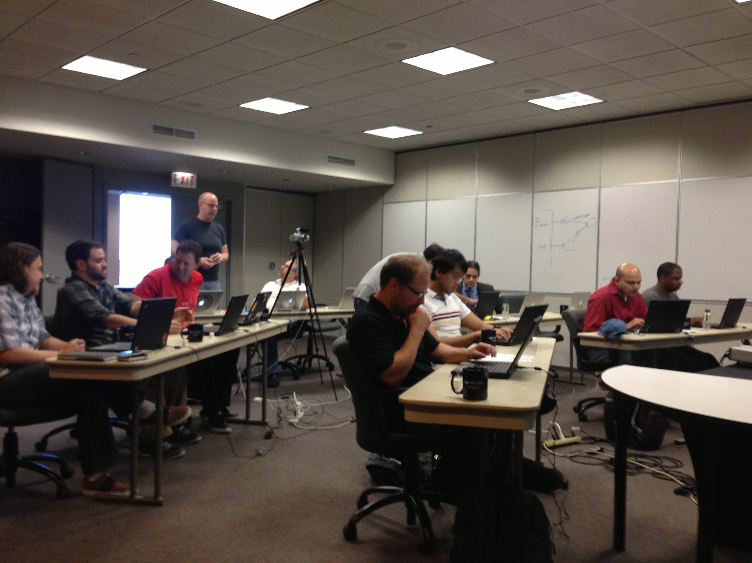

Slide 44
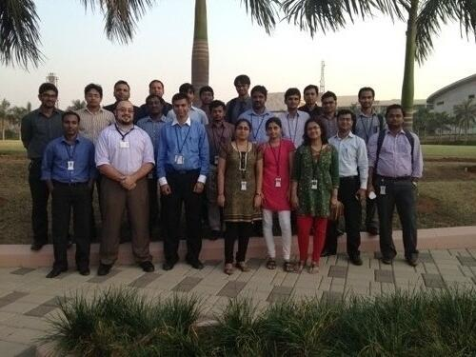
Easy to Learn - Support

Slide 45
Learn CanJS

Slide 46
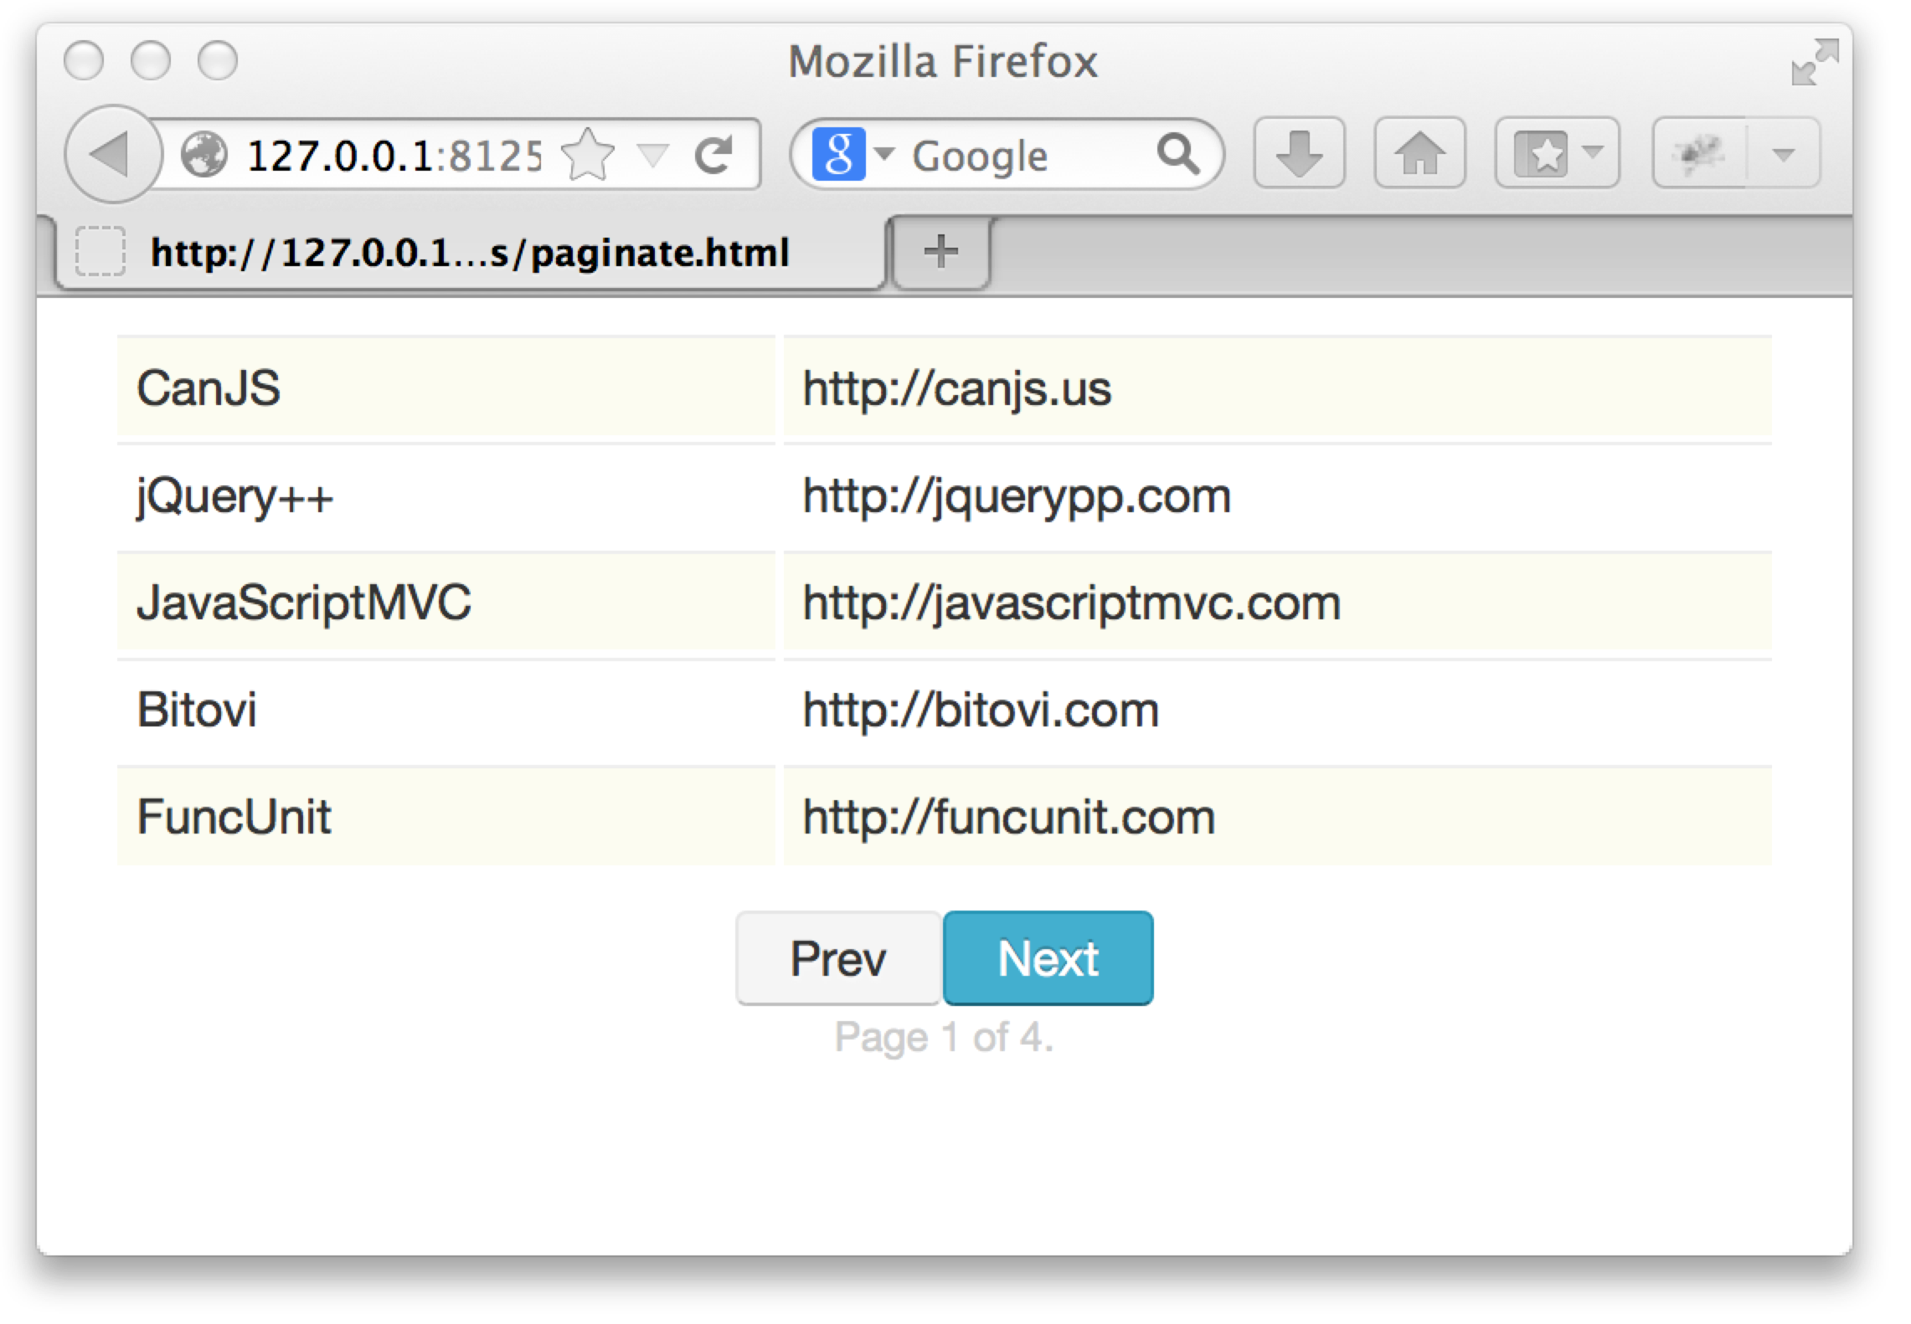
Paginate Demo
http://tinyurl.com/canjs-comp-ex

Slide 47
List Websites
<table id="websites"></table>
<script id="sites" type="text/mustache">
{{#each websites}}
<tr>
<td width='40%'>{{name}}</td>
<td width='70%'>{{url}}</td>
</tr>
{{/each}}
</script>

Slide 48
List Websites
var Website = can.Model.extend({
findAll: "/websites"
}, {});
Website.findAll( {limit:5, offset:0 },
function(webs){
var frag = can.view("sites",{
websites: webs
})
$("#websites").html( frag )
})

Slide 49
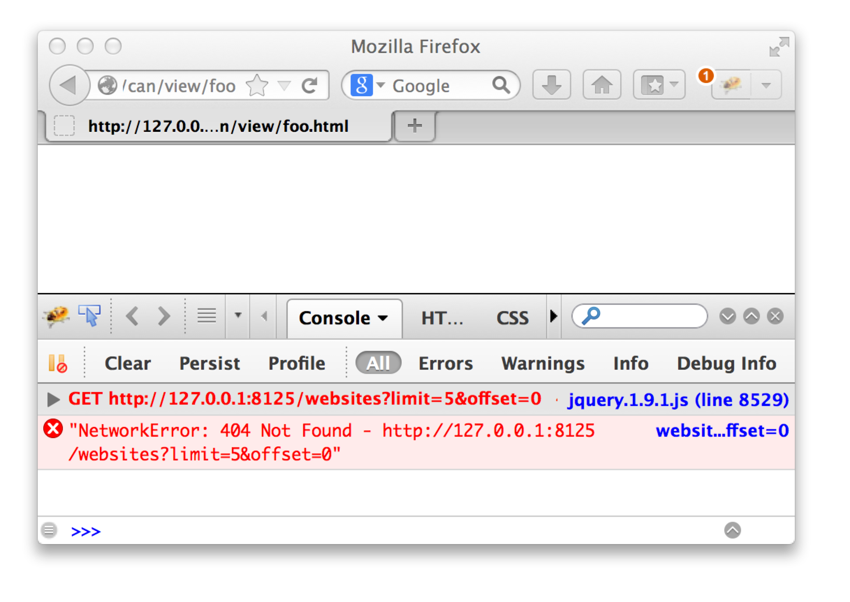
List Websites

Slide 50
Fixtures
var websites = [
{id:1,name:"CanJS",url:"http://canjs.us"},…
];
can.fixture("/websites", function(request){
var start = request.data.offset || 0,
end = start + request.data.limit;
return {
count: websites.length,
data: websites.slice(start, end)
}
});

Slide 51
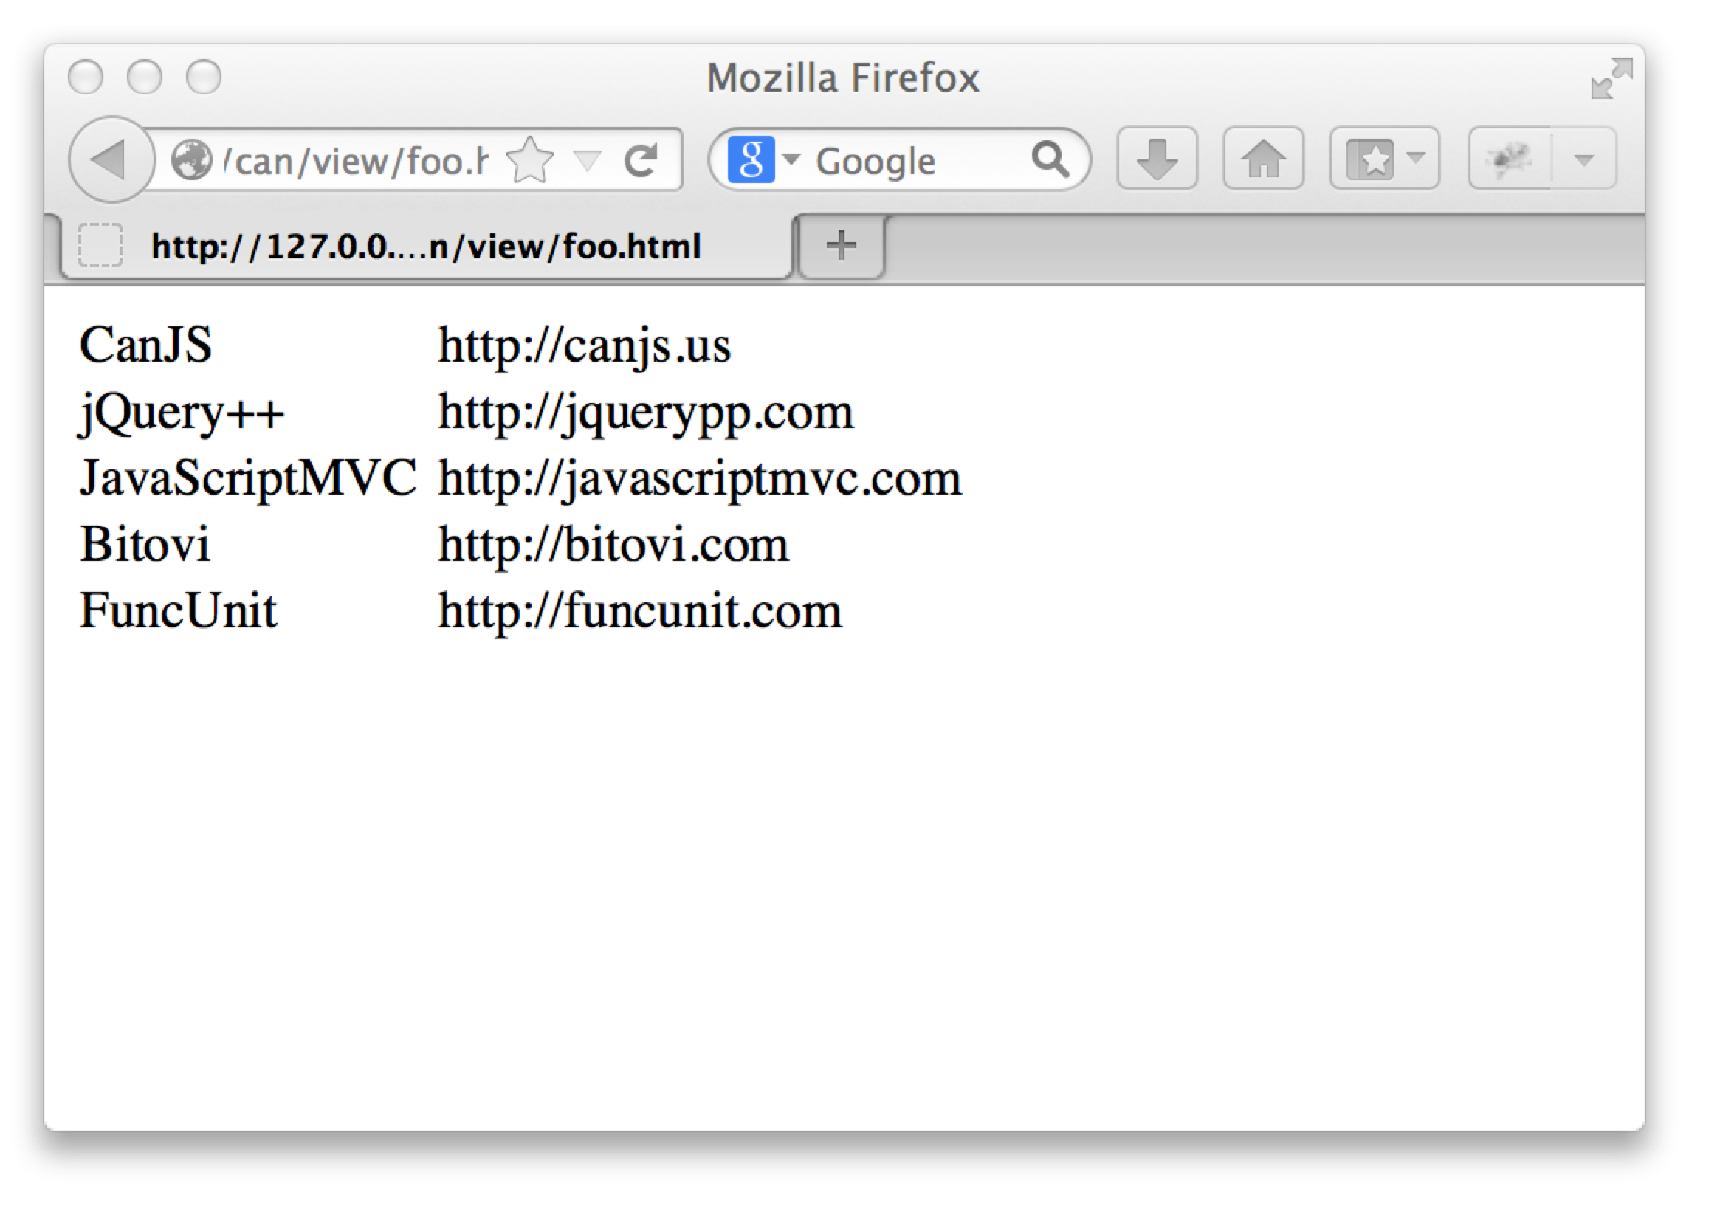
List Websites

Slide 52
Widgets and State?
Grid
.limit
.offset
.count
NextPrev
PageCount

Slide 53
Paginate State
var paginate = new can.Map({
limit: 5, offset: 0, count: 15
});
paginate.bind("offset",function(ev,newVal){
Website.findAll({limit:5,offset: newVal},
function(websites){
$("#websites").html( can.view("sites",{
websites: websites
})
})
});

Slide 54
Paginate Compute
var websitesCompute = can.compute(function(){
var param = {
limit: paginate.attr('limit'),
offset: paginate.attr('offset')
}
return new Website.List(param);
});
$("#websites").html( can.view("sites",{
websites: websitesComp
}));

Slide 55
Paginate Model
var Paginate = can.Map.extend({
count: Infinity,
offset: 0,
limit: 5,
next: function () {
this.attr('offset',
this.offset + this.limit);
}
});
var paginate = new Paginate();
paginate.next();

Slide 56
Paginate Model - Setters
var Paginate = can.Map.extend({
…
prev: function () {
this.attr('offset',
this.offset - this.limit);
},
setOffset: function (newOffset) {
return newOffset < 0 ?
0 :
Math.min(newOffset,
!isNaN(this.count - 1) ?
this.count - 1 :
Infinity)
}
});

Slide 57
Paginate Model - Helpers
var Paginate = can.Map.extend({
next: function () { … },
prev: function () { … },
setOffset: function () { … },
setCount: function () { … },
canNext: function () { … },
canPrev: function () {
return this.attr('offset') > 0
},
page: function () { … },
pageCount: function () { … }
});

Slide 58

NextPrev
new NextPrev("#next-prev",{
paginate: paginate
});

Slide 59
NextPrev’s Template
<script id="next-prev-stache"
type="text/mustache">
<a class="prev
{{#paginate.canPrev}}
enabled
{{/paginate.canPrev}}">Prev</a>
<a class="next
{{#paginate.canNext}}
enabled
{{/paginate.canNext}}">Next</a>
</script>

Slide 60
NextPrev can.Control
var NextPrev = can.Control({
init: function(){
this.element.html(
can.view('next-prev-stache',
this.options) );
},
".next click" : function(){
this.options.paginate.next();
},
".prev click" : function(){
this.options.paginate.prev();
}
});

Slide 61
NextPrev can.Component
<next-prev paginate='paginate'></next-prev>

Slide 62
NextPrev can.Component
can.Component.extend({
tag: "next-prev",
template:
'<a class="prev ' +
'{{#paginate.canPrev}}' +
'enabled' +
'{{/paginate.canPrev}}" ' +
'can-click="paginate.prev">Prev</a>'+
'<a class="next ' +
'{{#paginate.canNext}} ' +
'enabled' +
'{{/paginate.canNext}}" ' +
'can-click="paginate.next">Next</a>'
})

Slide 63
NextPrev can.Component
can.Component.extend({
tag: "next-prev",
template: can.view('next-prev-stache')
})

Slide 64

PageCount can.Component
<page-count
page='paginate.page'
count='paginate.pageCount'>
</page-count>

Slide 65
PageCount can.Component
can.Component.extend({
tag: "page-count",
template: 'Page <span>{{page}}</span> ' +
'of <span>{{count}}</span>.'
})

Slide 66
can.Component.extend(p)
can.Component.extend({
tag:"panel",
template: "{{#if active}}<content>…",
scope: {
active: false
},
helpers: {}
events: {
inserted: function(){...}
}
})
Notes:
JavaScript has 10 basic data types.
mutable

Slide 67
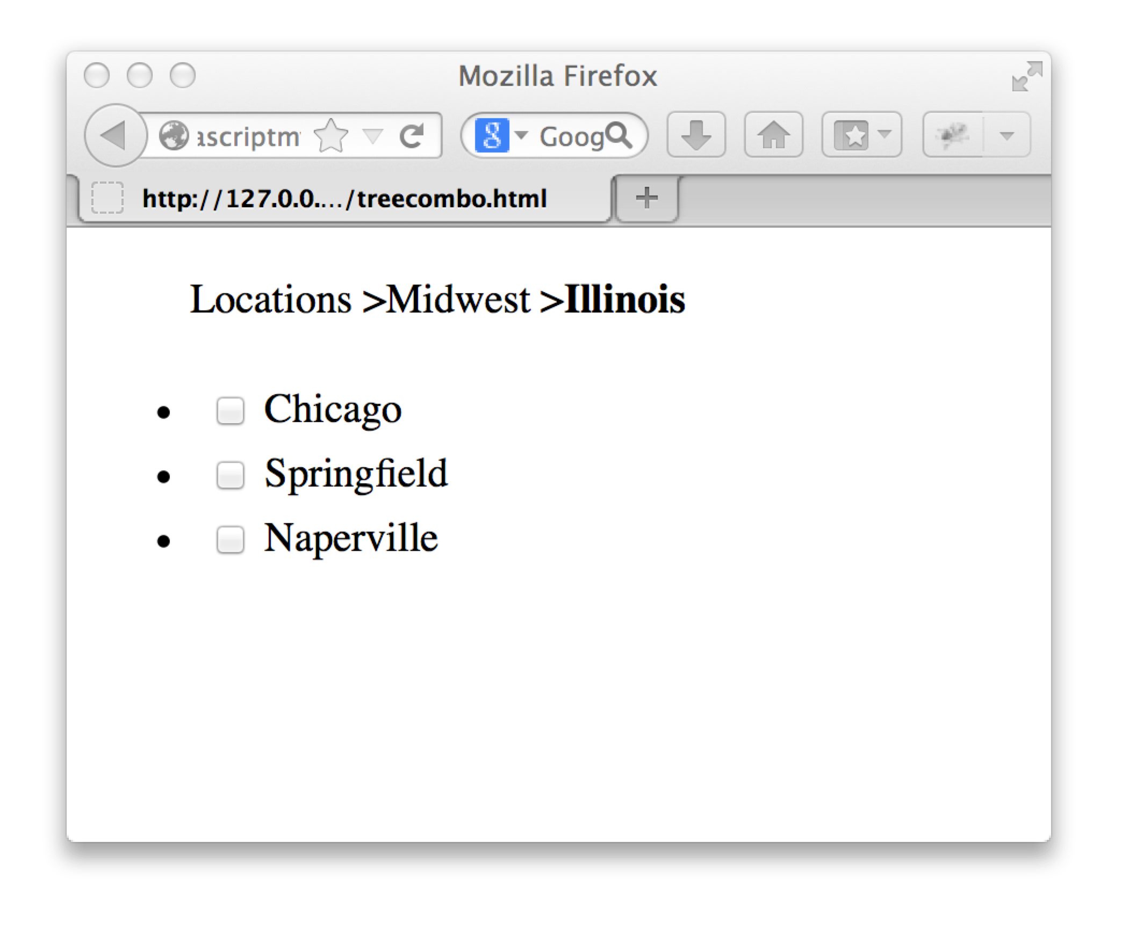

Slide 68
